Slide 1
CAPSTONE FINAL PRESENTATION
MIKE MCMULLEN & HART SINTERHAUF
SPONSORED BY PROF. TIAN ZHAO

Slide 2
RESEARCH PATH SO FAR
MQTT
lightweight TCP based subscribe and Publish mesaging protocol
Apache Spark
Process large volumes of streaming data using resilient distributed datasets (RDD = nodes)
DAG - multistep operational flow control with Actions and Transformations
ThingsBoard.io rule engine
Not efficient solution for programmers as the mechanics of stream composition is abstracted from the user
Node.js Stream Library
Reactive programming with Push based Streams
Created a module for:
Multiplexing and demultiplexing streams
Functionally composing streams based on provided callback
Functional Reactive Programming: REScala
Main objective switched from 'Glueing' IOT streams together with FRP to Providing Fault
Tolerance to existing solutions
Fault-Tolerant Distributed Reactive Programming: REScala
Fault-Tolerance in the context of Rx.js

Slide 3
RECAP & END OF SEMESTER GOALS
CREATE: Node.JS classes extending Rx.JS functionality
Fault Tolerant
Functionally Composable (like Observables)
REPORT:
display semester’s research in easy to understand format
DEMO: Web Based MCAS (Maneuvering Characteristics Augmentation System)
Send and Handle User Defined Invalid Data Values
Disconnect and Reconnect AOT Sensors Periodically
Log Events Clearly to Console

Slide 4
RX.JS
Library for composing asynchronous and event-based programs using observable sequences (streams)
Functional Operators similar to Map, Reduce, Filter
Observer Pattern - design pattern where object maintains a list of its dependents, called observers, and notifies them automatically of any state changes
Push Based - client automatically updates any dependents when it's value changes
Observables can be subscribed to with callbacks registered for various notifications (next, error, or complete)

Slide 5
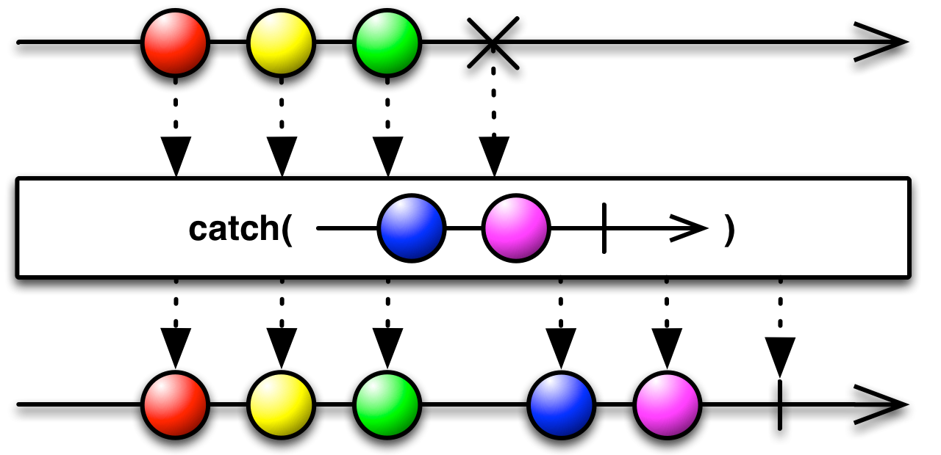
Observable Errors

Slide 6
Fault Tolerance
Faults:
Unanticipated connection lose due to network issues, or hardware failure
Missing or Invalid Data
Proposed Solutions for Recovery or Failing Gracefully
Eventual Consistency
Block dependent calculations until recovery
Handle Error Propagation
Restart Upstream on Error
Restart Self with Valid Value
Full restart with restored state (Extreme Case)

Slide 7
Existing Rx.JS Error Handling
Catch & Replace with CatchError Operator:
Input Observable, Callback Handler, Outputs Observable
Catch Error at source, Create new Observable
Only used once, new Observable can also throw Error
Retry Strategy
On Error retry subscribing to the input Observable to create new stream
This new stream can error out
Is prone to delays as it must wait for Notification Observable to send next event before retry

Slide 8
Problem:
Observables are NOT Fault-Tolerant
On Error, Observable completes
All Downstream and Upstream Observables also complete on Error
No method of restarting Observables on error

Slide 9
Solution:
Node.JS Class encapsulating Rx.JS functionality
Provide Initial valid value
Each Node maintains link to upstream parent(s)
Error callback should return a valid value
Value returned used as next valid value
Fault Tolerant for more than just one Error
Count number of faults
Used to restart stream or notify upstream to restart

Slide 10
Architecture Details
Docker Services:
SIMULATION
Rx.JS: MCAS simulation AOT Sensors
FRONTEND
React: Interactive Display and controls
SERVER
Socket.io + Express: provides Real time data synchronization between Frontend and MCAS demo

Slide 11
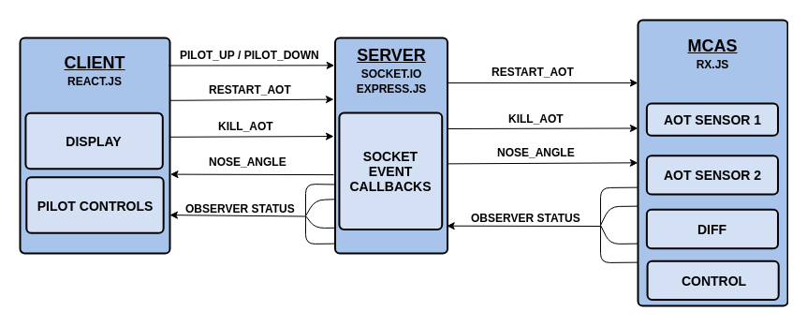
Demo Architecture

Slide 12
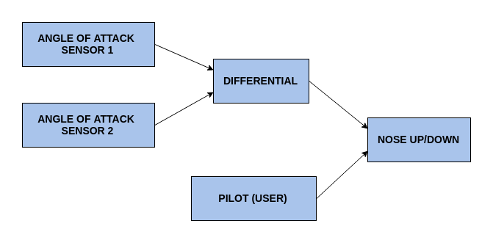
Demo Webpage

Slide 13
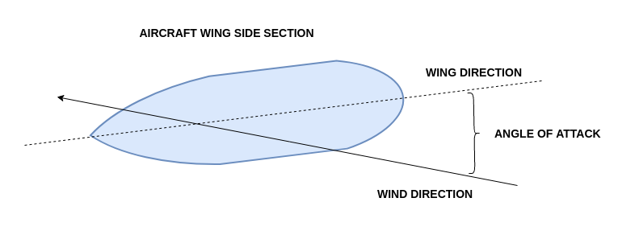
Demo Webpage

Slide 14
What’s Left
Create more event listeners for socket events reflecting status of MCAS Observers
Minor styling and D3 graph rendering issues
Create Real time animation of nose on Demo page
Add Background & Reports page to site
Dockerize and deploy project to Digital Ocean
Create logger of Docker Services output

